Slide 1
Video Captioning Papers

Slide 2
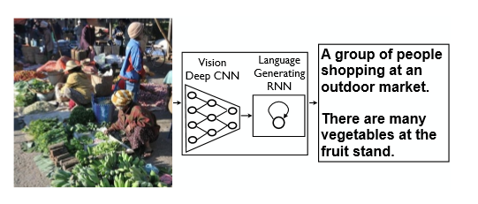
ShowandTell: ANeuralImageCaptionGenerator

Slide 3
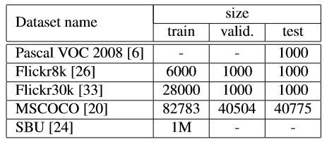
Dataset Used

Slide 4
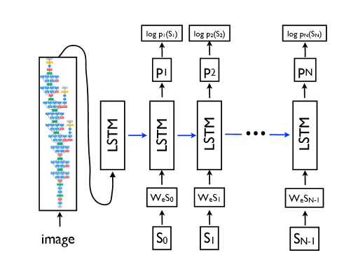
System Architeccture

Slide 5
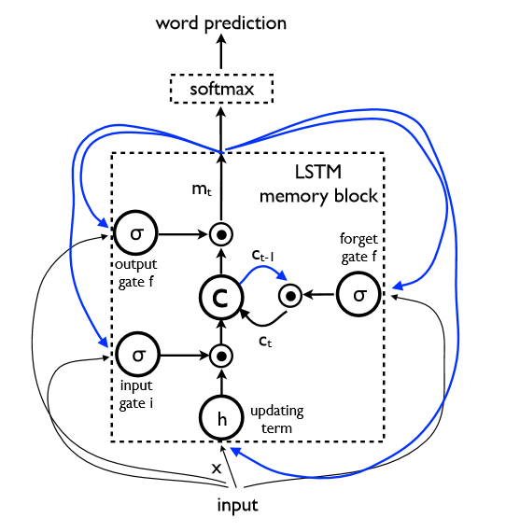
Single Unit OF LSTM

Slide 6
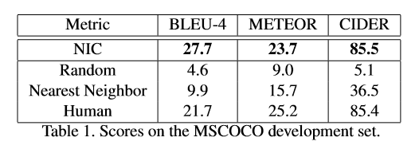
Experimental Results

